Slide 1

.NET LINQ
Ejaz Ahmed
(RPA Developer)

Slide 3

Agenda
Overview of LINQ
Syntax Styles
Benefits
Use Case

Slide 4
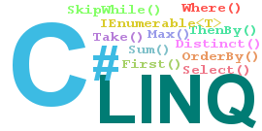
LINQ Overview
LINQ stands for Language Integrated Query.
It's a feature of .NET that allows you to query data from different data sources using a unified syntax.

Slide 5



Syntax Styles
Method Syntax
Query Syntax

Slide 6
Benefits
Simplicity : LINQ provides a simplified syntax, making it easier to write and understand complex queries.
Less Code : Multiple/nested loops are replaced with more compact form
Querying Multiple Data Sources: XML ,Json , Array, list, data table

Slide 7

LINQ Use Cases

Slide 8
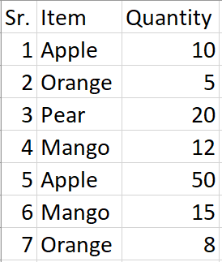
Use Case1
In your fruit data table, you have to retrieve the quantity value associated with the last occurrence of Mango

Slide 9
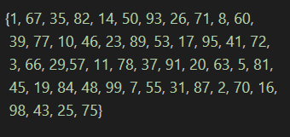

Use Case2
You have an array of 50 numbers ranging from 1 to 100. You have to output all the numbers in the array that are greater than a specified number provided by the user

Slide 10
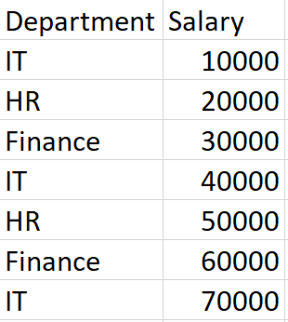

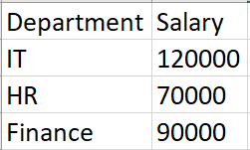
Use Case3
In data table, which contains departments and their corresponding salaries, your task is to calculate the total salary for each department.

Slide 11

Thank You

